Slide 1
Autonomous Driving with Remote Monitoring and Control
Group 3

Slide 2
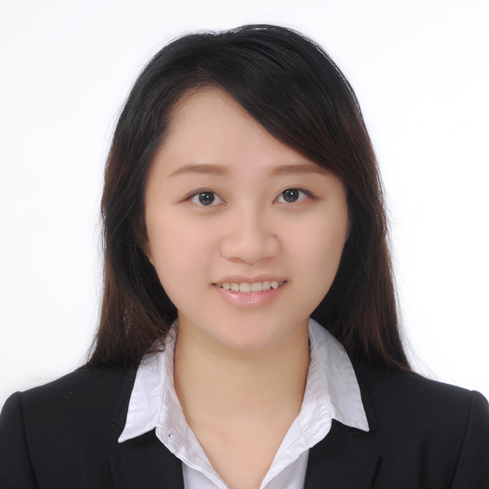
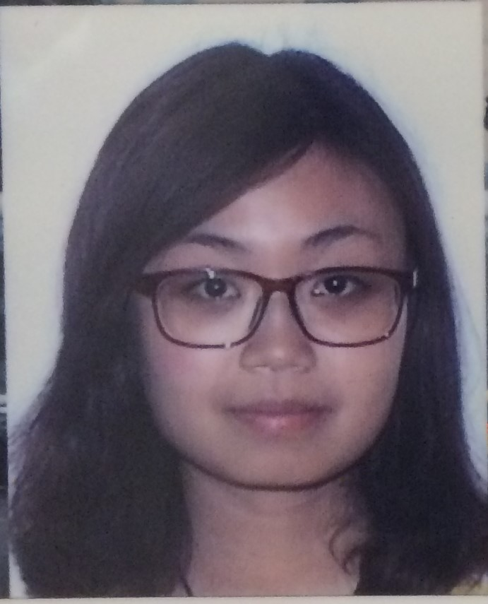
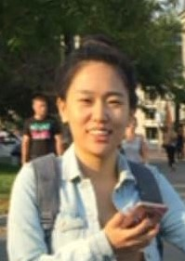
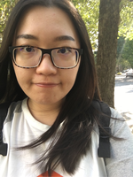
 | Lan Yao | Aoshuang Wang | Yixuan Huang | Lan Luo
Challenge 1 | Presenter
Challenge 2 |  |  | Presenter
Challenge 3 |  | Presenter
Challenge 4 |  |  |  | Presenter
Challenge 5 | Presenter
Challenge 6 |  |  | Presenter
Challenge 7 |  | Presenter
Challenge 8 |  |  |  | Presenter

Slide 3
Lan Yao | Aoshuang Wang | Yixuan Huang | Lan Luo
Program Writing(Autonomous Driving & Manual Control) Webpage Design | Program Writing(Autonomous Driving & Manual Control) Video Streaming | Hardware Access Webpage Design Localization | Program Writing(Autonomous Driving & Manual Control) Video Streaming

Slide 4
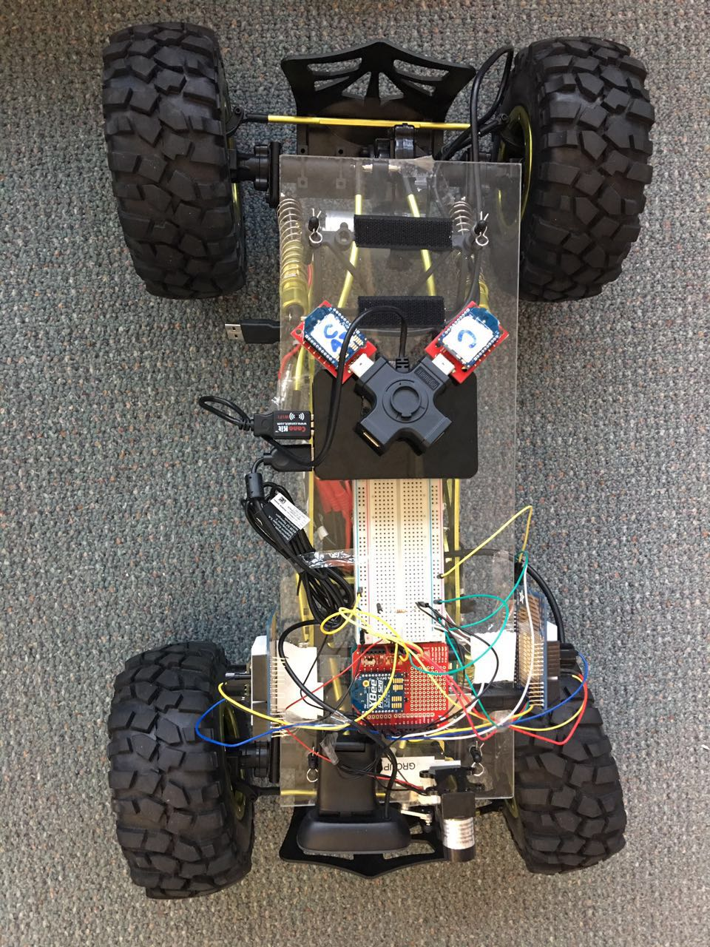
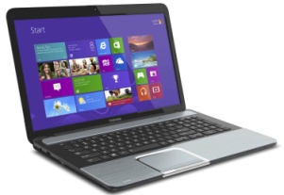
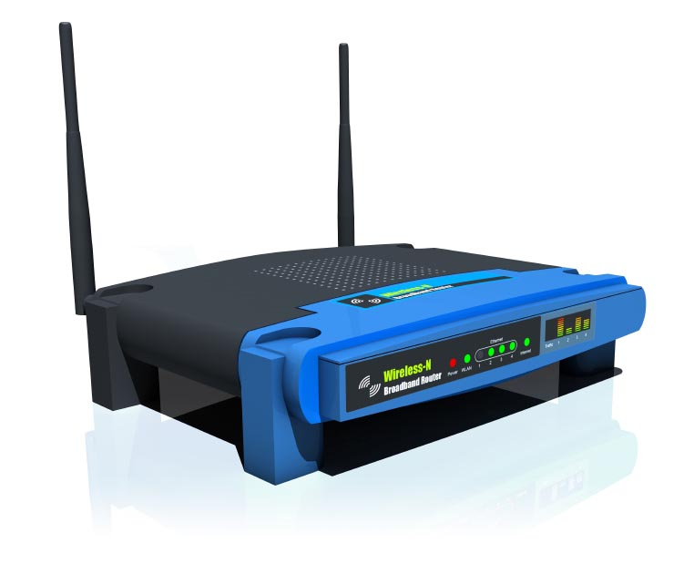
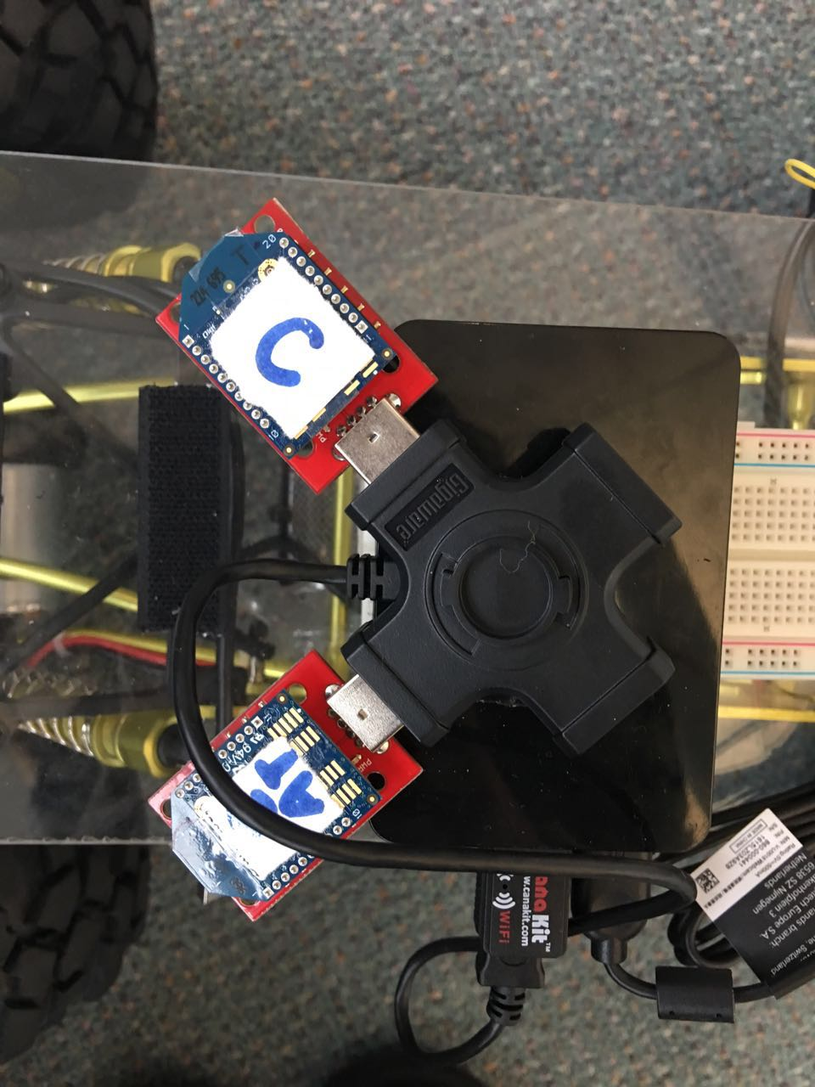
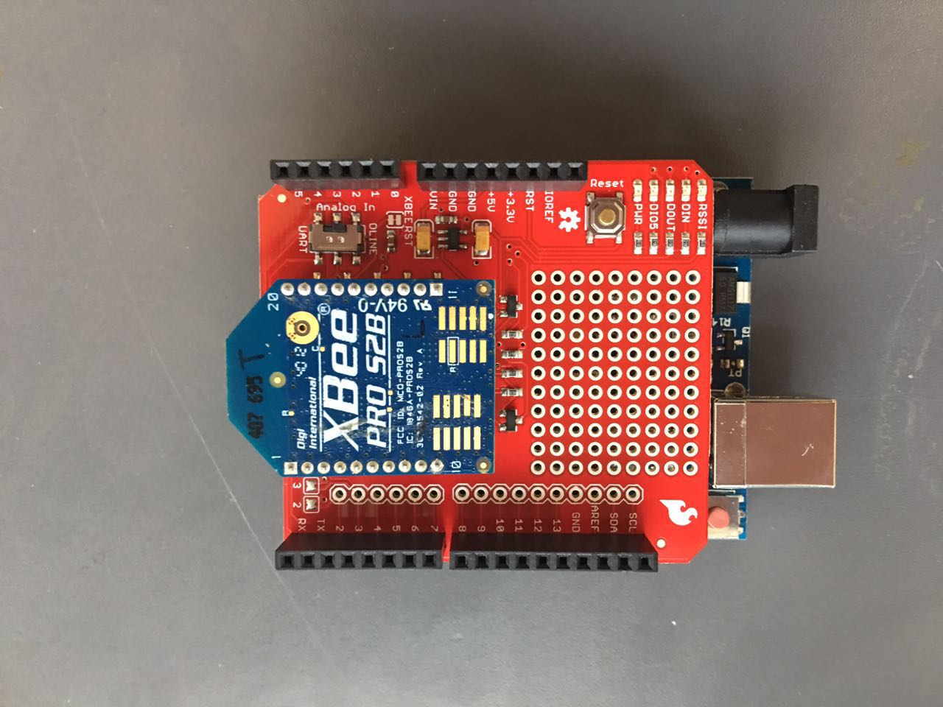
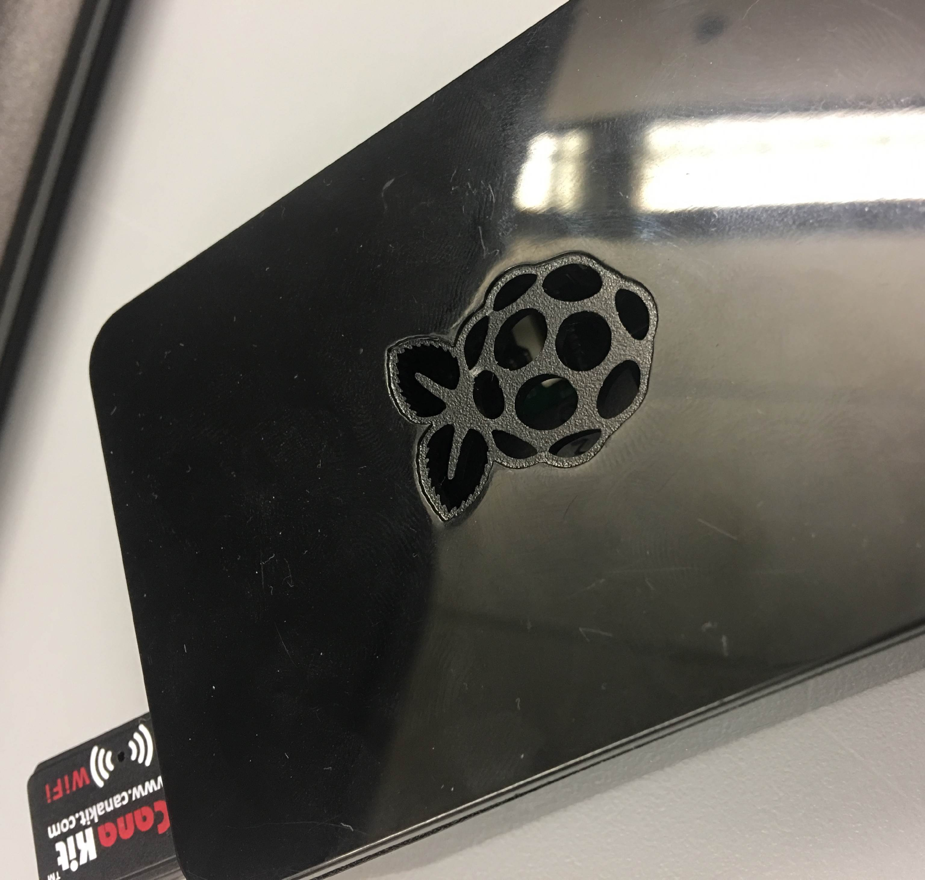
Devices
Laptop
Router
Crawler
Router Xbee(Arduino)
2 Coordinator Xbee
(AT & API)
Raspberry Pi

Slide 5
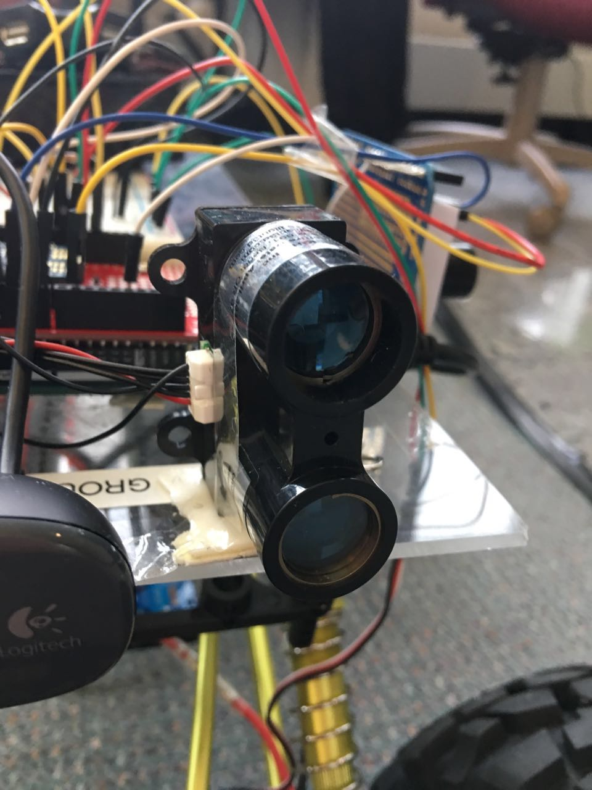
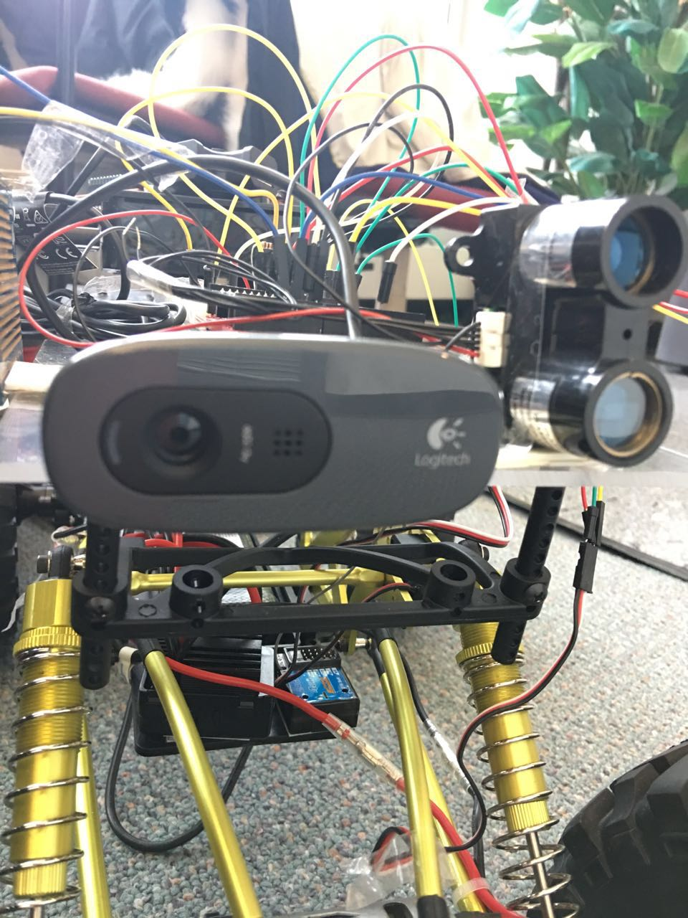
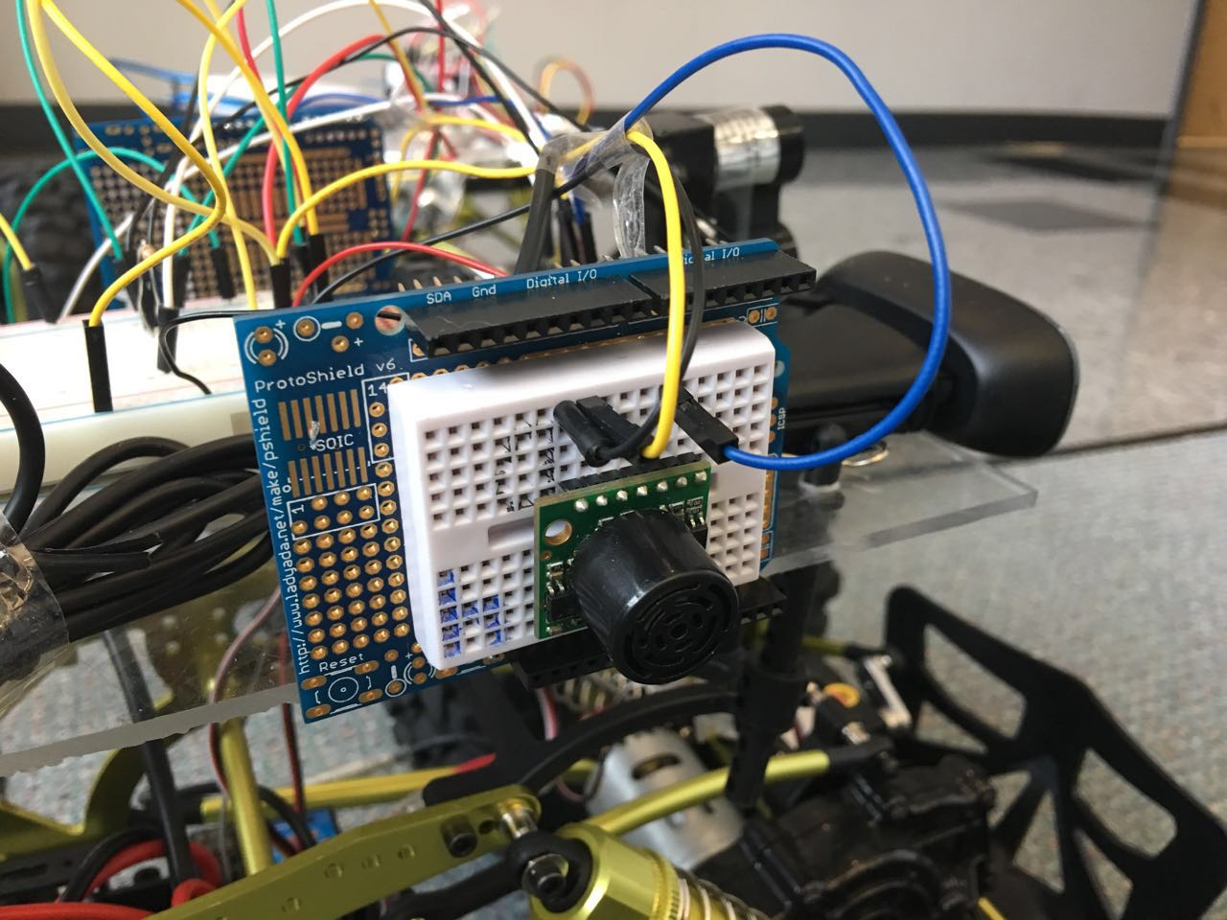
Sensors
Lidar
(front)
Sonic
(one for each sides)
Vedio Camera
(FPV)

Slide 6

Main Architecture
ESC(Speed)
Autonomous Driving
Controls
Coordinator Xbee
Wheels(Direction)

Slide 7
Main Architecture
Localization
RSSI Value
RSSI Value

Slide 8
Main Architecture
Video Streaming
MJPG
Webpage

Slide 9
Main Architecture
Remote Control
Webpage

Slide 10
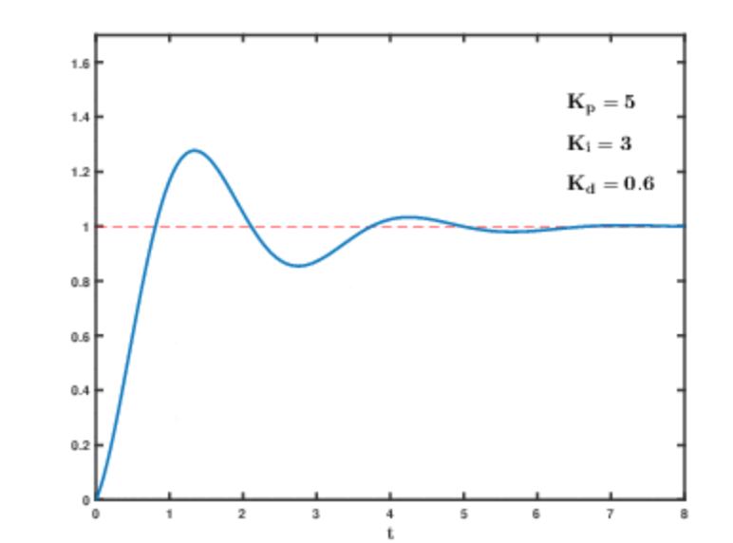
Design Details
PID:
Setpoint (desired output),
Input (real data),
Output (applied data through PID)

Slide 11
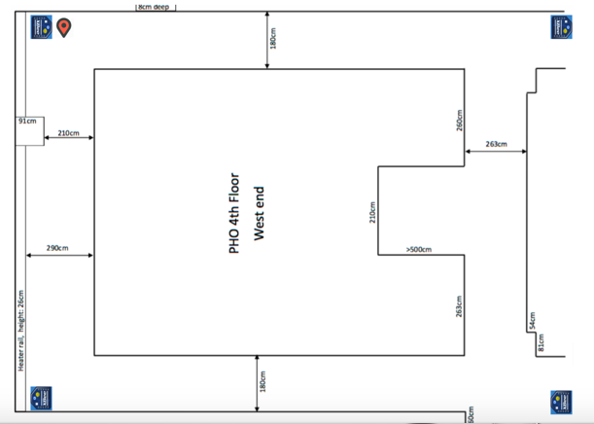
Design Details
Localization
KNN

Slide 12
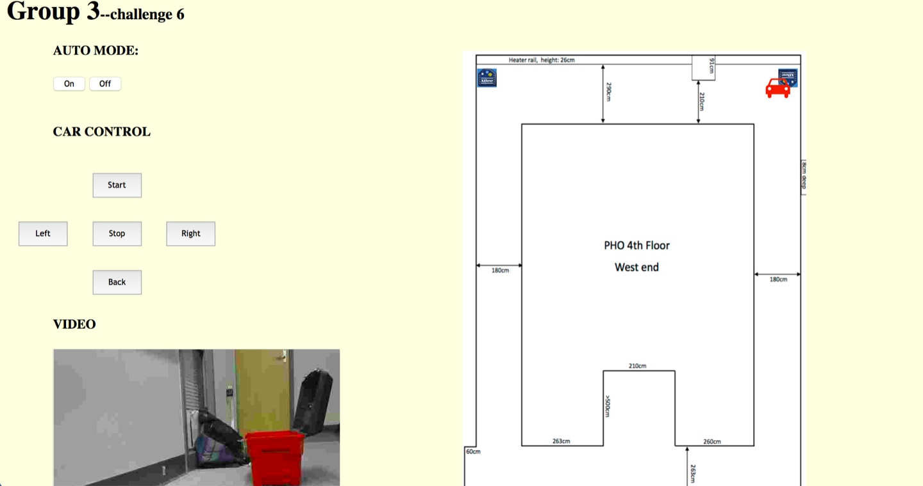
Design Details
Keyboard Control

Slide 13
Challenges
Delay of the RSS
Keyboard Control
Elevator Corner
Range of WIFI

